Slide 1
PREDICTIVE ANALYSIS OF CRIME LOCATIONS IN LOS ANGELES
Shashidhar Manoharan and Geslande Belus
Project Presentation: Phase 3
Presented by Team F
Team’s Github Page Link

Slide 2
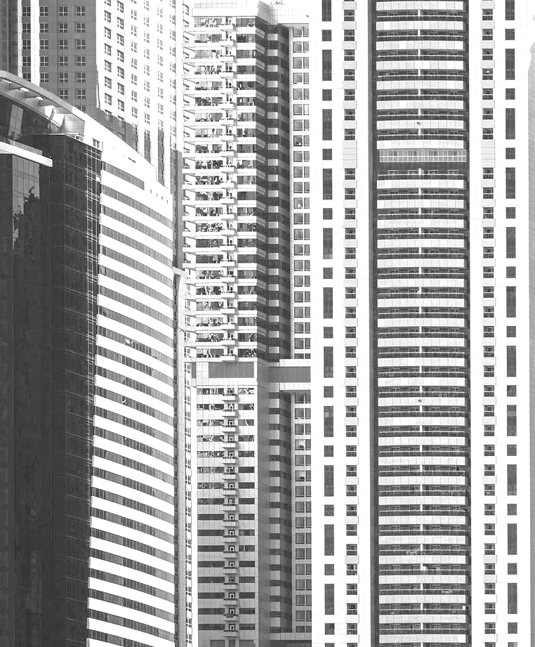

AGENDA
GitHub Repository
Project and Dataset Overview
Exploratory Data Analysis (EDA)
Literature Survey
Model Construction
Model Evaluation
Results
Examples on Map
Future Improvements
References
Notes:
Geslande: "Let's look at what we'll discuss today, starting with our research question, followed by an introduction to our dataset, and moving through our analytical methods to our future plans."

Slide 3
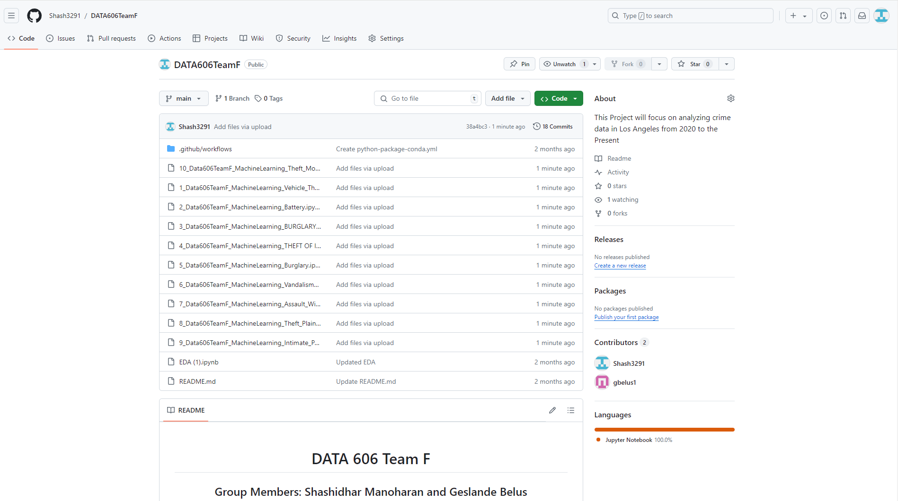
Github Page Screenshot

Slide 4
Project Overview
About
Why this Project?
Research Question/Hypothesis
Aim to utilize historical crime data from 2020 till the present in Los Angeles in order to predict potential crime hotspots for different crimes in the city.
Aim to utilize various features in the dataset such as date occurred, time occurred, victim age, victim sex and more in order to make these predictions
Aim to use machine learning regression algorithms to accomplish this task
Crime is something we want to cut down in the world as much as possible
If we have the ability to understand where certain crimes are located, we can adequately distribute necessary resources to those areas to tackle that specific crime.
This project can be used as a resource in this resource allocation process
Research Question: Can machine learning regression algorithms accurately predict the latitude and longitude locations of different types of crimes in Los Angeles using data from 2020 to the present?
Hypothesis: By analyzing crime data from 2020 to the present, machine learning regression algorithms can effectively predict the specific latitude and longitude of future crimes in Los Angeles sorted by crime

Slide 5

DATASET INTRODUCTION
Los Angeles Crime Data from 2020 to 2024: LINK
947,776 crime records total
26 total features
2 target variables (latitude and longitude)
Will be creating a regression model for prediction
Plan to test linear regression, polynomial regression, decision tree, random forest, and neural networks
Notes:
NOTE: dataset, i.e. describe the dataset and what kind of machine learning (ML) or data analyses (DA) will you do on it (prediction?classification?clustering?) Provide a link to the dataset, a clear description i.e. clear info on data size, #instances/#samples, #raw attributes, #features you can most likely select/extract/use, will you do a classification or prediction, if it is a classification how many categories, i.e. number of categories, what are the categories etc.).
Speaker: “Through the use of machine learning models, our objective is to forecast the locations of criminal acts in Los Angeles by taking into account a number of influential factors, including the time, date, and demographics of the victims.”

Slide 6
Similar Approaches Refresher
Some people have uploaded this dataset to Kaggle
Almost entirely just EDA
Random Forest/Logistic Regression models used in one example (predicting whether case would be solved)
Saw a Plotly interactive map that we definitely want to try and adjust towards our own project
Research Paper in Denmark on figuring out the route’s criminals took from their house to the places of crime in order to determine what “routes” are causing people to commit crimes the most
Concept doesn’t make much sense, drawing a line from someone's house to the location of the crime
Research Paper of someone trying to predict everything about a crime (place, time, type)
Only in theory, no actual code
Doe, J., & Smith, B. (2012). Crime prediction using machine learning algorithms. Proceedings of the IEEE International Conference on Data Mining, 210-215. https://doi.org/10.1109/ICDM.2012.6298814
GusLovesMath. (2020). Los Angeles Crime Data Quick EDA. Kaggle. https://www.kaggle.com/code/guslovesmath/los-angeles-crime-data-quick-eda
Notes:
NOTE: what is the state of the art? what’s missing?

Slide 7
Similar Approaches (cont.)
Prediction of crime rate in urban neighborhoods based on machine learning is another similar study that provides insights, advancements and challenges in using machine learning for geographic location prediction.
Summary: This study used Generative Adversarial Networks (GANs) to forecast crime distribution across city layouts using over two million Philadelphia crime data points from 2006 to 2018.
State of the Art
Multi-output Regression
Deep Learning Applications
Generative Models
Current Gaps and Challenges
Data Integration Complexity
Scalability and Real-time Processing
Computational Efficiency
Adaptive Learning Models
He, J., & Zheng, H. (2021). Prediction of crime rate in urban neighborhoods based on machine learning. Engineering Applications of Artificial Intelligence, 106(104460). https://doi.org/10.1016/j.engappai.2021.104460
Notes:
Summary:
This research uses Generative Adversarial Networks (GANs) to forecast crime distribution across city layouts using over two million Philadelphia crime data points from 2006 to 2018. The algorithm generates crime hotspot maps for urban planning and security by training using thousands of one-to-one city floor plan and crime data pictures. The model accurately forecasts crime concentration locations, allowing planners to change city designs and perhaps lower crime rates with approaches that may be extended to other urban features.
Modern Improvements
Machine learning is improving latitude and longitude prediction. Multi-output regression models increase prediction accuracy and reliability by correlating numerous outputs. LSMs and Convolutional Neural Networks have also helped. Models that grasp complex spatial and temporal patterns are vital for urban planning, environmental monitoring, and public safety.
Generative models, notably GANs, are changing how we simulate and predict urban crime and city planning. These models' very precise geographic data simulations allow urban planners and scholars to imagine future changes and their impacts without testing.
Presently Challenged
We encounter obstacles. Spatial autocorrelation complicates many machine learning models. To create useful datasets from various data sources, thorough preparation and data fusion are needed.
Scalability and real-time processing are challenges. As cities develop and data volumes rise, our algorithms must scale to give real-time traffic management and crime mapping insights.
Model generalization is difficult. How can we ensure a model trained in one location works in another? This unanswered question is fundamental to universal replies

Slide 8
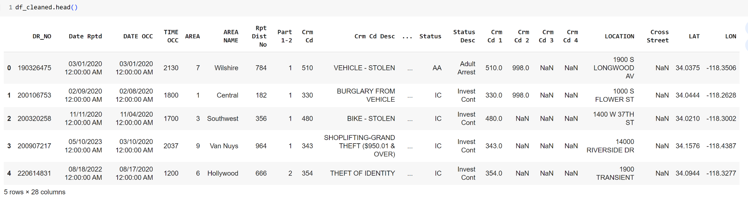
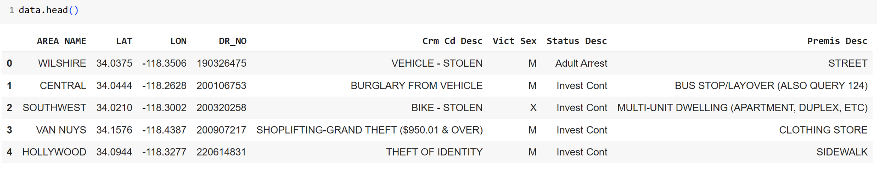
DATA PREP

Slide 9
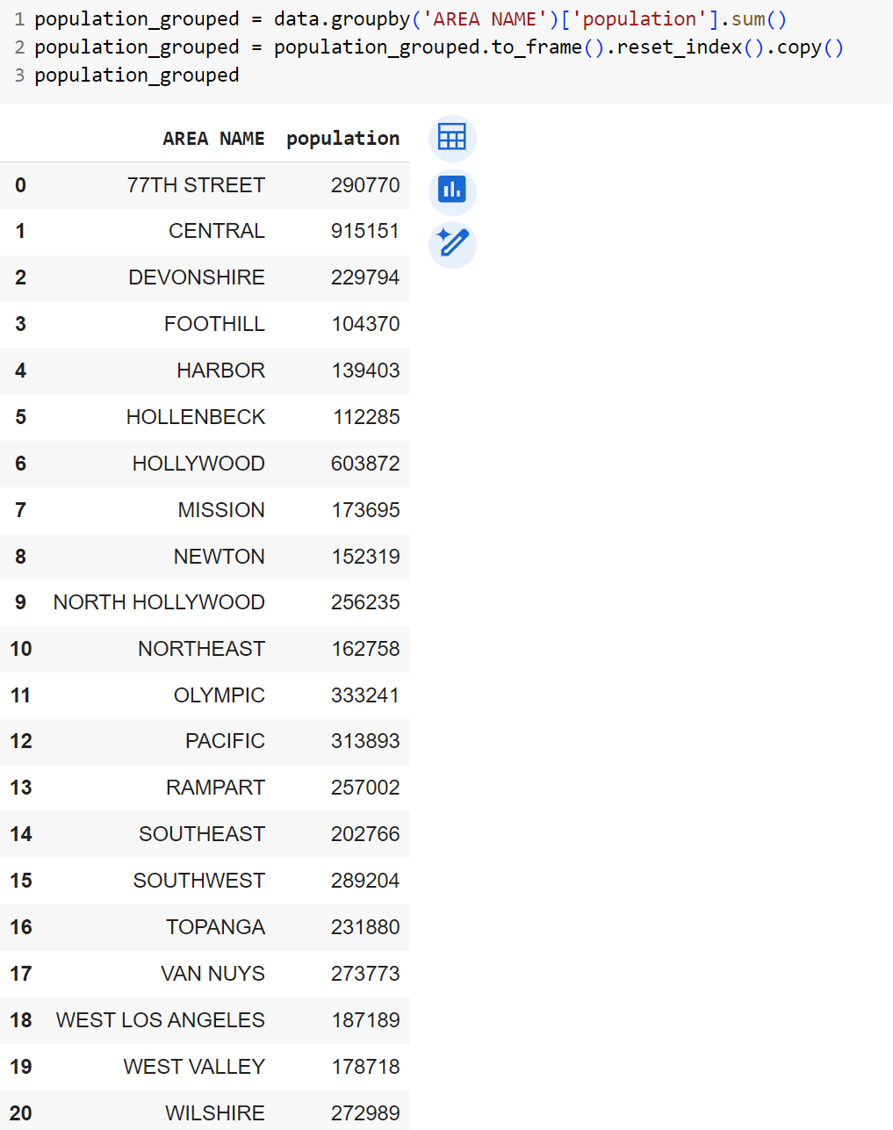
Population Count by Area Name

Slide 10
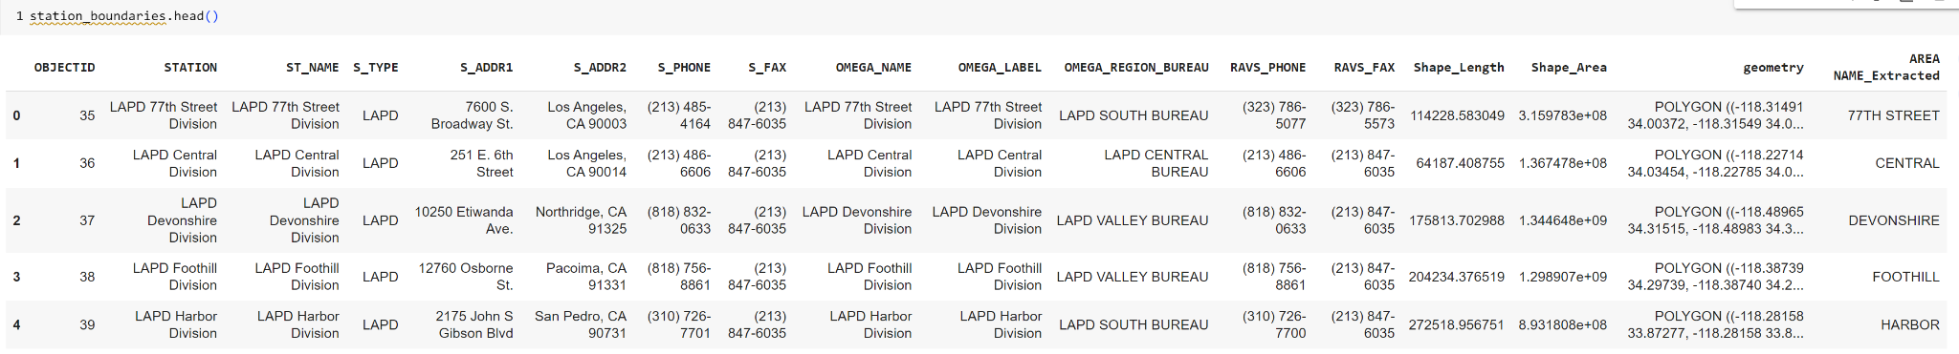
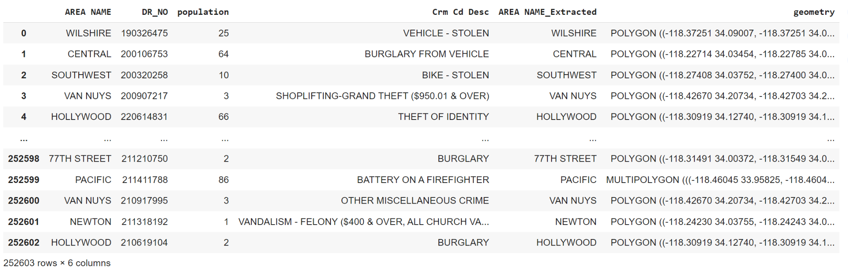
GeoData

Slide 11
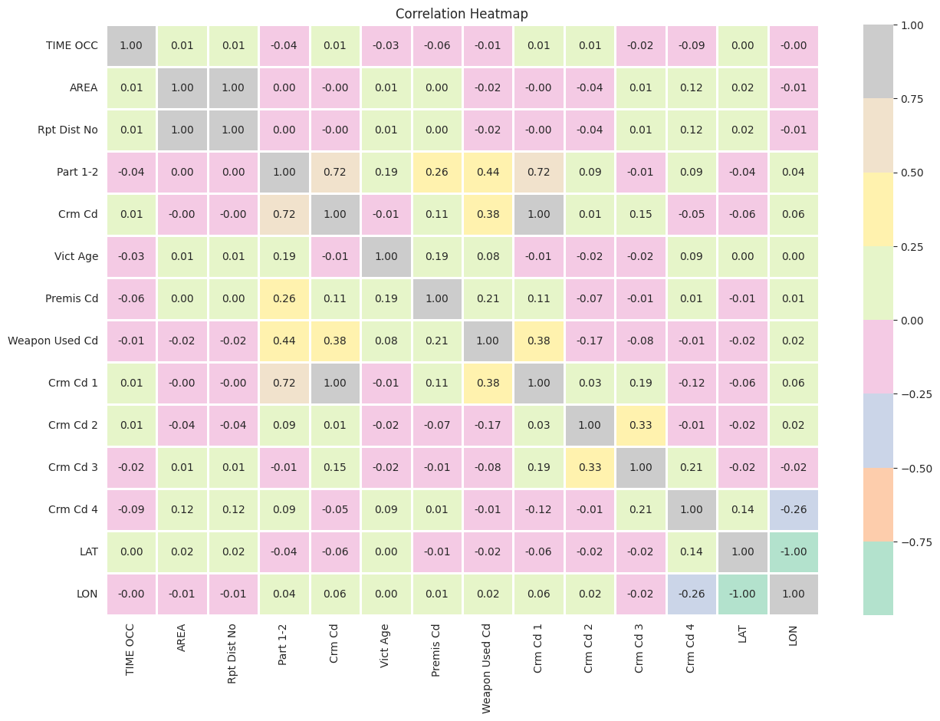
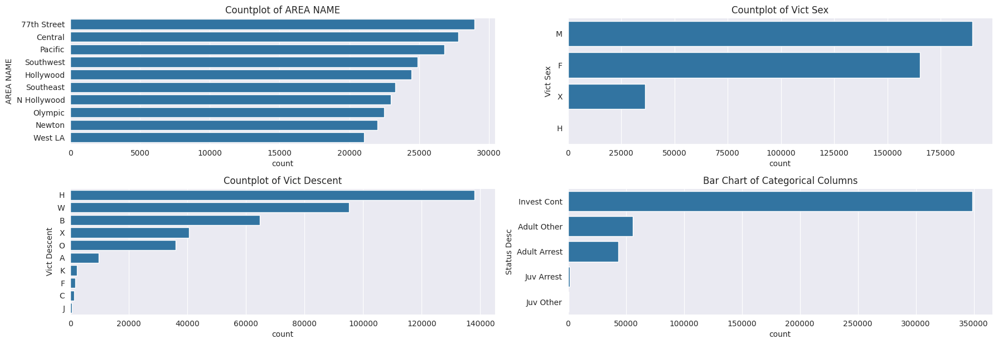
EDA
EXPLORATORY DATA ANALYSIS (EDA)
Donec risus dolor porta venenatis
Pharetra luctus felis
Proin vel tellus in felis volutpat
Molestie nec amet cum sociis
GeeksforGeeks. (n.d.). Exploratory Data Analysis in Python. Retrieved [Date you accessed the information], from https://www.geeksforgeeks.org/exploratory-data-analysis-in-python/

Slide 12
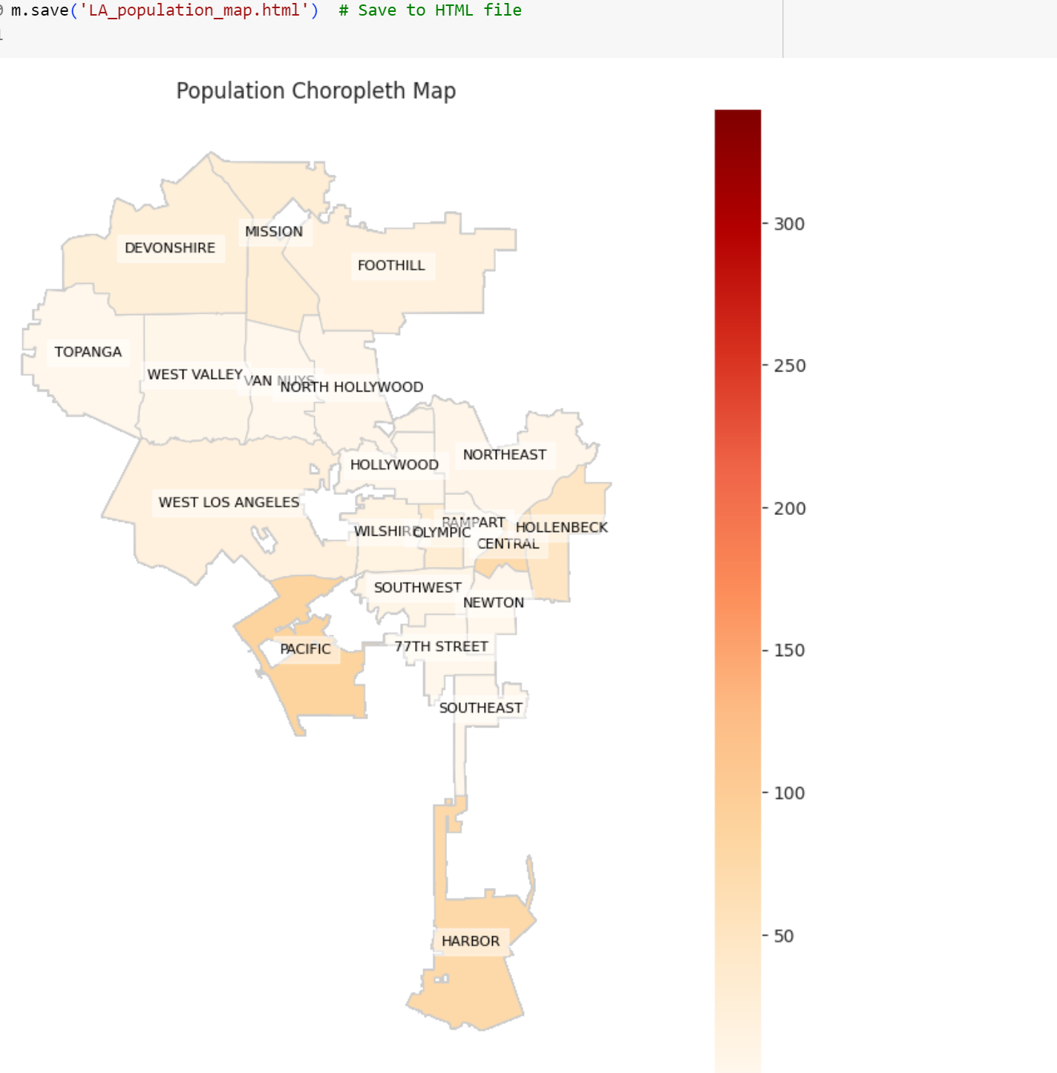
Visualizations

Slide 13
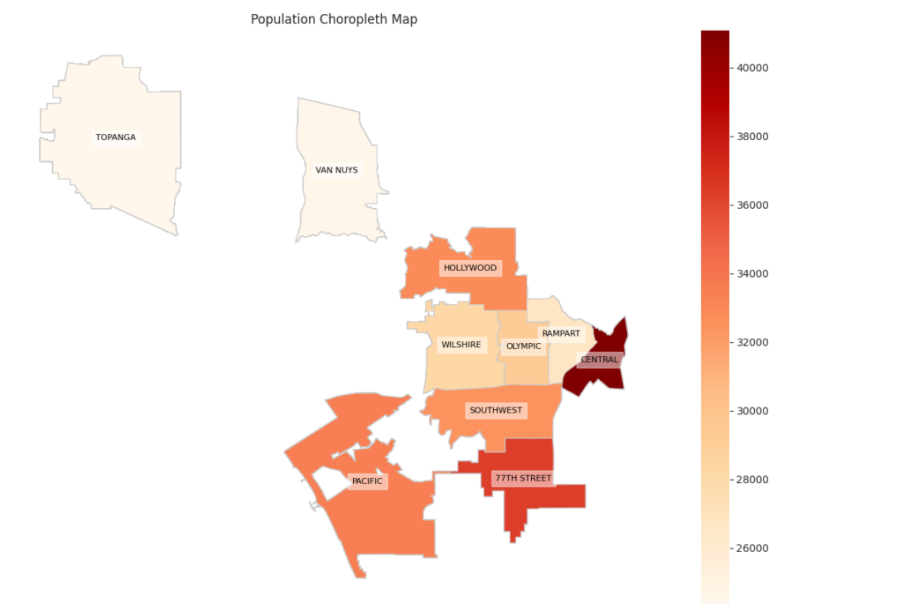
Choropleth Map
TOP 10 AREA WITH THE HIGHEST CRIMES

Slide 14
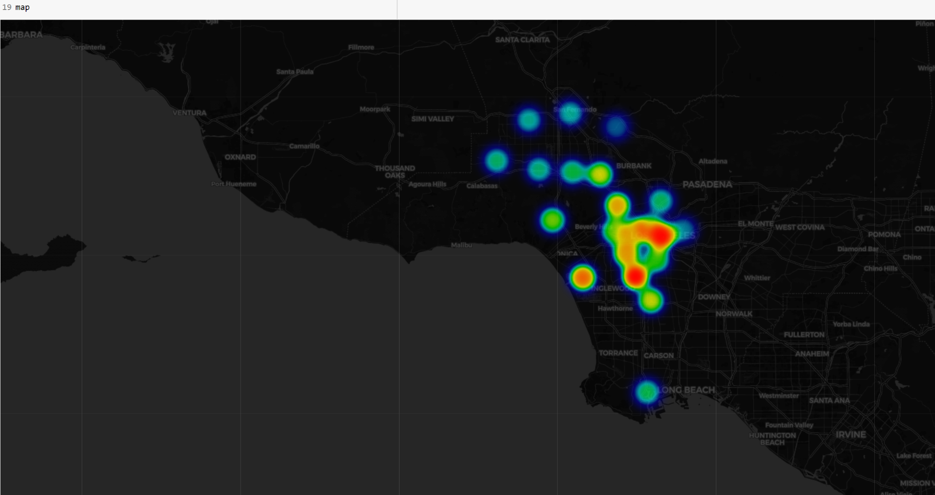
HeatMap

Slide 15
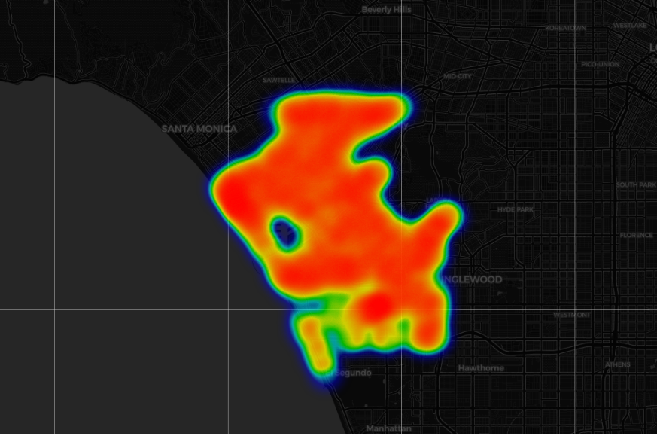
HeatMap

Slide 16
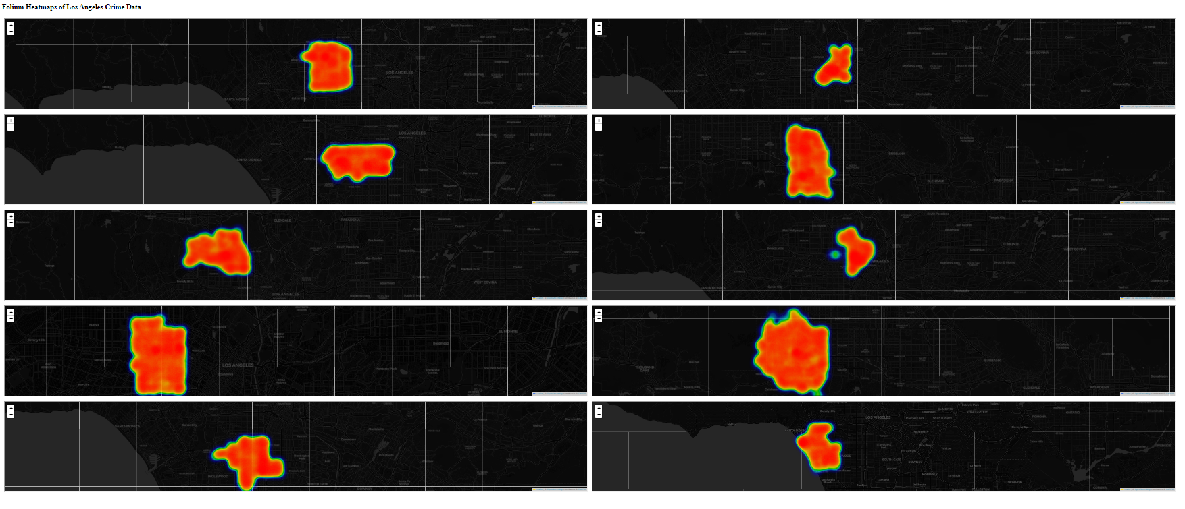
Heatmaps of Los Angeles Crime Data

Slide 17
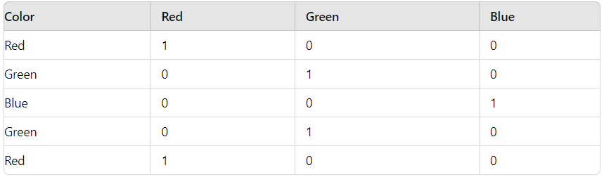
Machine Learning Models
Focused on the following models:
Linear Regression
Decision Tree Regression
Random Forest Regression
Tested Gradient Boosting, Polynomial Regression (2nd Degree and above) but too time consuming to run and poorly performed
Dealt with categorical data using one-hot encoding

Slide 18
Machine Learning Models (cont.)
Data used an 80:20 split (80% of data for training, 20% of data for testing
Ran each algorithm 5 times, took the average of the 5 R^2 values to analyze how the models were performing for more accuracy
Decided to only sample 10,000 data points maximum for each crime type for runtime reasons

Slide 19
Machine Learning Model Results 1
Crime Type: Theft Of Vehicle
LAT
 | Train R2 1 | Test R2 1 | Train R2 2 | Train R2 3 | Train R2 3 | Test R2 3 | Train R2 4 | Test R2 4 | Train R2 5 | Test R2 5 | AVG Train | AVG Test
Linear | 0.342 | 0.293 | 0.251 | 0.326 | 0.382 | 0.317 | 0.234 | 0.272 | 0.295 | 0.354 | 0.301 | 0.312
Random Forest | 0.821 | 0.785 | 0.753 | 0.799 | 0.812 | 0.765 | 0.734 | 0.725 | 0.798 | 0.843 | 0.784 | 0.783
Decision Tree | 0.862 | 0.791 | 0.827 | 0.873 | 0.854 | 0.822 | 0.781 | 0.769 | 0.897 | 0.856 | 0.844 | 0.822
LON
 | Train R2 1 | Test R2 1 | Train R2 2 | Train R2 3 | Train R2 3 | Test R2 3 | Train R2 4 | Test R2 4 | Train R2 5 | Test R2 5 | AVG Train | AVG Test
Linear | 0.327 | 0.244 | 0.392 | 0.374 | 0.151 | 0.299 | 0.219 | 0.184 | 0.336 | 0.321 | 0.285 | 0.284
Random Forest | 0.783 | 0.762 | 0.795 | 0.780 | 0.788 | 0.772 | 0.772 | 0.761 | 0.780 | 0.769 | 0.783 | 0.769
Decision Tree | 0.750 | 0.735 | 0.765 | 0.752 | 0.740 | 0.725 | 0.755 | 0.740 | 0.748 | 0.738 | 0.751 | 0.738

Slide 20
Machine Learning Model Results 2
Crime Type: BATTERY - SIMPLE ASSAULT
LAT
 | Train R2 1 | Test R2 1 | Train R2 2 | Train R2 3 | Train R2 3 | Test R2 3 | Train R2 4 | Test R2 4 | Train R2 5 | Test R2 5 | AVG Train | AVG Test
Linear | 0.318 | 0.255 | 0.213 | 0.324 | 0.295 | 0.379 | 0.176 | 0.222 | 0.347 | 0.193 | 0.270 | 0.275
Random Forest | 0.832 | 0.816 | 0.844 | 0.825 | 0.830 | 0.812 | 0.811 | 0.798 | 0.820 | 0.804 | 0.827 | 0.811
Decision Tree | 0.859 | 0.844 | 0.871 | 0.856 | 0.850 | 0.832 | 0.860 | 0.844 | 0.842 | 0.826 | 0.856 | 0.850
LON
 | Train R2 1 | Test R2 1 | Train R2 2 | Train R2 3 | Train R2 3 | Test R2 3 | Train R2 4 | Test R2 4 | Train R2 5 | Test R2 5 | AVG Train | AVG Test
Linear | 0.173 | 0.391 | 0.348 | 0.259 | 0.285 | 0.145 | 0.197 | 0.352 | 0.375 | 0.211 | 0.276 | 0.272
Random Forest | 0.785 | 0.769 | 0.790 | 0.773 | 0.800 | 0.784 | 0.775 | 0.759 | 0.785 | 0.770 | 0.787 | 0.771
Decision Tree | 0.794 | 0.776 | 0.810 | 0.792 | 0.785 | 0.770 | 0.805 | 0.788 | 0.790 | 0.774 | 0.797 | 0.780

Slide 21
Machine Learning Model Results 3
Crime Type: BURGLARY FROM VEHICLE
LAT
 | Train R2 1 | Test R2 1 | Train R2 2 | Train R2 3 | Train R2 3 | Test R2 3 | Train R2 4 | Test R2 4 | Train R2 5 | Test R2 5 | AVG Train | AVG Test
Linear | 0.293 | 0.376 | 0.189 | 0.265 | 0.315 | 0.182 | 0.234 | 0.354 | 0.362 | 0.219 | 0.279 | 0.279
Random Forest | 0.859 | 0.847 | 0.870 | 0.855 | 0.846 | 0.836 | 0.867 | 0.848 | 0.851 | 0.842 | 0.859 | 0.865
Decision Tree | 0.782 | 0.768 | 0.795 | 0.782 | 0.790 | 0.779 | 0.803 | 0.788 | 0.788 | 0.775 | 0.791 | 0.778
LON
 | Train R2 1 | Test R2 1 | Train R2 2 | Train R2 3 | Train R2 3 | Test R2 3 | Train R2 4 | Test R2 4 | Train R2 5 | Test R2 5 | AVG Train | AVG Test
Linear | 0.276 | 0.346 | 0.452 | 0.489 | 0.369 | 0.219 | 0.312 | 0.411 | 0.478 | 0.275 | 0.377 | 0.348
Random Forest | 0.854 | 0.837 | 0.876 | 0.855 | 0.862 | 0.848 | 0.868 | 0.860 | 0.855 | 0.840 | 0.863 | 0.848
Decision Tree | 0.783 | 0.772 | 0.792 | 0.775 | 0.796 | 0.780 | 0.805 | 0.788 | 0.784 | 0.770 | 0.792 | 0.771

Slide 22
Machine Learning Model Results 4
Crime Type: THEFT OF IDENTITY
LAT
 | Train R2 1 | Test R2 1 | Train R2 2 | Train R2 3 | Train R2 3 | Test R2 3 | Train R2 4 | Test R2 4 | Train R2 5 | Test R2 5 | AVG Train | AVG Test
Linear | 0.382 | 0.312 | 0.492 | 0.472 | 0.269 | 0.315 | 0.418 | 0.339 | 0.339 | 0.217 | 0.380 | 0.331
Random Forest | 0.883 | 0.867 | 0.875 | 0.854 | 0.890 | 0.874 | 0.868 | 0.855 | 0.878 | 0.862 | 0.879 | 0.862
Decision Tree | 0.747 | 0.735 | 0.760 | 0.743 | 0.755 | 0.740 | 0.765 | 0.755 | 0.750 | 0.740 | 0.755 | 0.743
LON
 | Train R2 1 | Test R2 1 | Train R2 2 | Train R2 3 | Train R2 3 | Test R2 3 | Train R2 4 | Test R2 4 | Train R2 5 | Test R2 5 | AVG Train | AVG Test
Linear | 0.323 | 0.145 | 0.442 | 0.509 | 0.517 | 0.308 | 0.276 | 0.168 | 0.529 | 0.277 | 0.417 | 0.281
Random Forest | 0.825 | 0.798 | 0.847 | 0.765 | 0.812 | 0.785 | 0.868 | 0.782 | 0.834 | 0.794 | 0.777 | 0.800
Decision Tree | 0.853 | 0.832 | 0.875 | 0.810 | 0.872 | 0.831 | 0.887 | 0.814 | 0.845 | 0.820 | 0.835 | 0.809

Slide 23
Machine Learning Model Results 5
Crime Type: BURGLARY
LAT
 | Train R2 1 | Test R2 1 | Train R2 2 | Train R2 3 | Train R2 3 | Test R2 3 | Train R2 4 | Test R2 4 | Train R2 5 | Test R2 5 | AVG Train | AVG Test
Linear | 0.112 | 0.327 | 0.198 | 0.207 | 0.198 | 0.335 | 0.056 | 0.222 | 0.341 | 0.102 | 0.241 | 0.198
Random Forest | 0.752 | 0.741 | 0.783 | 0.749 | 0.804 | 0.758 | 0.790 | 0.754 | 0.772 | 0.735 | 0.780 | 0.747
Decision Tree | 0.762 | 0.740 | 0.780 | 0.752 | 0.793 | 0.749 | 0.785 | 0.741 | 0.769 | 0.755 | 0.778 | 0.747
LON
 | Train R2 1 | Test R2 1 | Train R2 2 | Train R2 3 | Train R2 3 | Test R2 3 | Train R2 4 | Test R2 4 | Train R2 5 | Test R2 5 | AVG Train | AVG Test
Linear | 0.154 | 0.376 | 0.311 | 0.185 | 0.278 | 0.222 | 0.367 | 0.148 | 0.203 | 0.096 | 0.262 | 0.205
Random Forest | 0.778 | 0.759 | 0.791 | 0.765 | 0.805 | 0.771 | 0.788 | 0.750 | 0.773 | 0.762 | 0.787 | 0.761
Decision Tree | 0.785 | 0.764 | 0.790 | 0.770 | 0.800 | 0.768 | 0.782 | 0.753 | 0.777 | 0.756 | 0.787 | 0.762

Slide 24
Machine Learning Model Results 6
Crime Type: VANDALISM - FELONY ($400 & OVER, ALL CHURCH VANDALISMS)
LAT
 | Train R2 1 | Test R2 1 | Train R2 2 | Train R2 3 | Train R2 3 | Test R2 3 | Train R2 4 | Test R2 4 | Train R2 5 | Test R2 5 | AVG Train | AVG Test
Linear | 0.217 | 0.102 | 0.338 | 0.354 | 0.135 | 0.137 | 0.395 | 0.193 | 0.178 | 0.245 | 0.252 | 0.206
Random Forest | 0.752 | 0.740 | 0.785 | 0.763 | 0.792 | 0.748 | 0.773 | 0.757 | 0.767 | 0.752 | 0.772 | 0.752
Decision Tree | 0.779 | 0.762 | 0.787 | 0.751 | 0.794 | 0.758 | 0.765 | 0.749 | 0.772 | 0.759 | 0.779 | 0.755
LON
 | Train R2 1 | Test R2 1 | Train R2 2 | Train R2 3 | Train R2 3 | Test R2 3 | Train R2 4 | Test R2 4 | Train R2 5 | Test R2 5 | AVG Train | AVG Test
Linear | 0.225 | 0.310 | 0.321 | 0.152 | 0.174 | 0.109 | 0.260 | 0.295 | 0.339 | 0.218 | 0.264 | 0.217
Random Forest | 0.760 | 0.750 | 0.783 | 0.740 | 0.795 | 0.769 | 0.772 | 0.754 | 0.770 | 0.758 | 0.772 | 0.754
Decision Tree | 0.767 | 0.752 | 0.783 | 0.769 | 0.796 | 0.758 | 0.774 | 0.763 | 0.770 | 0.755 | 0.778 | 0.759

Slide 25
Machine Learning Model Results 7
Crime Type: ASSAULT WITH DEADLY WEAPON, AGGRAVATED ASSAULT
LAT
 | Train R2 1 | Test R2 1 | Train R2 2 | Test R2 3 | Train R2 3 | Test R2 3 | Train R2 4 | Test R2 4 | Train R2 5 | Test R2 5 | AVG Train | AVG Test
Linear | 0.302 | 0.223 | 0.283 | 0.351 | 0.317 | 0.167 | 0.290 | 0.379 | 0.312 | 0.205 | 0.281 | 0.265
Random Forest | 0.758 | 0.765 | 0.785 | 0.770 | 0.792 | 0.755 | 0.773 | 0.762 | 0.779 | 0.772 | 0.777 | 0.765
Decision Tree | 0.763 | 0.772 | 0.788 | 0.757 | 0.796 | 0.762 | 0.780 | 0.764 | 0.775 | 0.769 | 0.780 | 0.765
LON
 | Train R2 1 | Test R2 1 | Train R2 2 | Test R2 3 | Train R2 3 | Test R2 3 | Train R2 4 | Test R2 4 | Train R2 5 | Test R2 5 | AVG Train | AVG Test
Linear | 0.298 | 0.231 | 0.235 | 0.357 | 0.312 | 0.198 | 0.287 | 0.318 | 0.394 | 0.126 | 0.305 | 0.246
Random Forest | 0.767 | 0.765 | 0.785 | 0.772 | 0.794 | 0.758 | 0.774 | 0.769 | 0.780 | 0.759 | 0.780 | 0.765
Decision Tree | 0.772 | 0.758 | 0.790 | 0.775 | 0.788 | 0.769 | 0.782 | 0.762 | 0.769 | 0.754 | 0.780 | 0.764

Slide 26
Machine Learning Model Results 8
Crime Type: THEFT PLAIN - PETTY ($950 & UNDER)
LAT
 | Train R2 1 | Test R2 1 | Train R2 2 | Test R2 3 | Train R2 3 | Test R2 3 | Train R2 4 | Test R2 4 | Train R2 5 | Test R2 5 | AVG Train | AVG Test
Linear | 0.157 | 0.190 | 0.176 | 0.155 | 0.183 | 0.167 | 0.146 | 0.190 | 0.162 | 0.180 | 0.165 | 0.176
Random Forest | 0.824 | 0.835 | 0.842 | 0.821 | 0.856 | 0.844 | 0.838 | 0.830 | 0.812 | 0.818 | 0.814 | 0.819
Decision Tree | 0.812 | 0.831 | 0.830 | 0.815 | 0.846 | 0.828 | 0.854 | 0.809 | 0.842 | 0.817 | 0.828 | 0.800
LON
 | Train R2 1 | Test R2 1 | Train R2 2 | Test R2 3 | Train R2 3 | Test R2 3 | Train R2 4 | Test R2 4 | Train R2 5 | Test R2 5 | AVG Train | AVG Test
Linear | 0.188 | 0.171 | 0.142 | 0.155 | 0.198 | 0.182 | 0.160 | 0.150 | 0.175 | 0.165 | 0.172 | 0.164
Random Forest | 0.836 | 0.832 | 0.855 | 0.843 | 0.842 | 0.851 | 0.824 | 0.830 | 0.810 | 0.825 | 0.833 | 0.830
Decision Tree | 0.845 | 0.855 | 0.832 | 0.846 | 0.851 | 0.821 | 0.825 | 0.831 | 0.812 | 0.808 | 0.826 | 0.827

Slide 27
Machine Learning Model Results 9
Crime Type: INTIMATE PARTNER - SIMPLE ASSAULT
LAT
 | Train R2 1 | Test R2 1 | Train R2 2 | Test R2 3 | Train R2 3 | Test R2 3 | Train R2 4 | Test R2 4 | Train R2 5 | Test R2 5 | AVG Train | AVG Test
Linear | 0.222 | 0.094 | 0.318 | 0.387 | 0.141 | 0.245 | 0.278 | 0.348 | 0.356 | 0.121 | 0.263 | 0.239
Random Forest | 0.763 | 0.772 | 0.788 | 0.759 | 0.779 | 0.765 | 0.780 | 0.758 | 0.785 | 0.769 | 0.779 | 0.765
Decision Tree | 0.770 | 0.764 | 0.783 | 0.755 | 0.795 | 0.769 | 0.779 | 0.762 | 0.784 | 0.760 | 0.782 | 0.762
LON
 | Train R2 1 | Test R2 1 | Train R2 2 | Test R2 3 | Train R2 3 | Test R2 3 | Train R2 4 | Test R2 4 | Train R2 5 | Test R2 5 | AVG Train | AVG Test
Linear | 0.315 | 0.140 | 0.265 | 0.215 | 0.394 | 0.054 | 0.187 | 0.422 | 0.049 | 0.287 | 0.242 | 0.224
Random Forest | 0.836 | 0.774 | 0.786 | 0.767 | 0.775 | 0.763 | 0.790 | 0.759 | 0.772 | 0.751 | 0.778 | 0.763
Decision Tree | 0.781 | 0.764 | 0.774 | 0.759 | 0.790 | 0.766 | 0.772 | 0.755 | 0.785 | 0.762 | 0.780 | 0.761

Slide 28
Machine Learning Model Results 10
Crime Type: THEFT FROM MOTOR VEHICLE - PETTY ($950 & UNDER)
LAT
 | Train R2 1 | Test R2 1 | Train R2 2 | Test R2 3 | Train R2 3 | Test R2 3 | Train R2 4 | Test R2 4 | Train R2 5 | Test R2 5 | AVG Train | AVG Test
Linear | 0.212 | 0.141 | 0.284 | 0.067 | 0.359 | 0.325 | 0.113 | 0.397 | 0.206 | 0.090 | 0.235 | 0.184
Random Forest | 0.812 | 0.820 | 0.836 | 0.811 | 0.850 | 0.823 | 0.828 | 0.815 | 0.846 | 0.805 | 0.850 | 0.811
Decision Tree | 0.808 | 0.814 | 0.825 | 0.819 | 0.838 | 0.824 | 0.847 | 0.821 | 0.816 | 0.808 | 0.827 | 0.817
LON
 | Train R2 1 | Test R2 1 | Train R2 2 | Test R2 3 | Train R2 3 | Test R2 3 | Train R2 4 | Test R2 4 | Train R2 5 | Test R2 5 | AVG Train | AVG Test
Linear | 0.418 | 0.174 | 0.322 | 0.095 | 0.131 | 0.235 | 0.263 | 0.304 | 0.356 | 0.087 | 0.298 | 0.179
Random Forest | 0.818 | 0.822 | 0.825 | 0.830 | 0.834 | 0.810 | 0.812 | 0.822 | 0.843 | 0.819 | 0.818 | 0.822
Decision Tree | 0.827 | 0.819 | 0.835 | 0.826 | 0.850 | 0.830 | 0.818 | 0.824 | 0.836 | 0.821 | 0.833 | 0.824

Slide 29
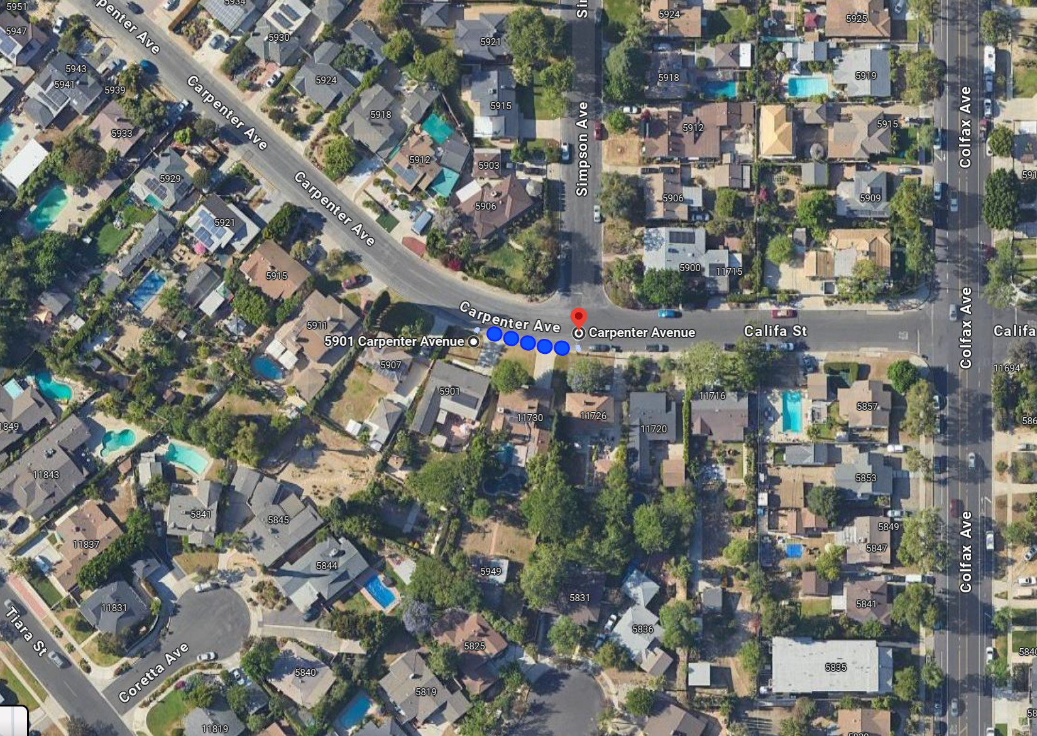
What would this look like on a map? (Good)
Crime Type: THEFT FROM MOTOR VEHICLE - PETTY ($950 & UNDER)
West Adams, Los Angeles

Slide 30
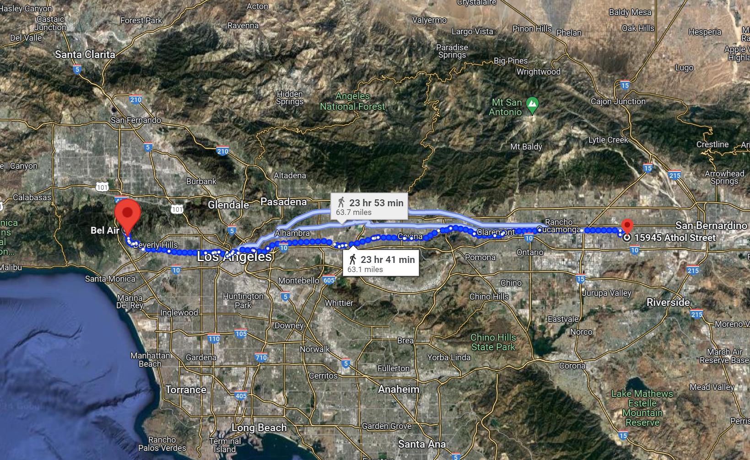
What would this look like on a map? (Bad)
Crime Type: THEFT FROM MOTOR VEHICLE - PETTY ($950 & UNDER)
Bel Air, Los Angeles

Slide 31
Conclusions/Future Improvements
Nothing really similarly performed online on this data set to compare with
Linear regression performed badly which makes sense
Random Forest and Decision Tree Regression Performed relatively well supporting our initial hypothesis
A bit of overfitting occurred for some crimes around which can be improved upon in the future through even more detailed hyperparameter changes
Could use entire dataset instead of a sample of 10,000 values maximum
Add better coded map to show differences between actual and predicted locations

Slide 32

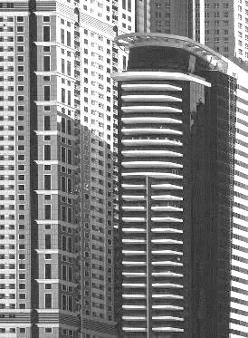


REFERENCES
City of Los Angeles. (2020). Crime Data from 2020 to Present. LA City Data. https://data.lacity.org/Public-Safety/Crime-Data-from-2020-to-Present/2nrs-mtv8/about_data
Doe, J., & Smith, B. (2012). Crime prediction using machine learning algorithms. Proceedings of the IEEE International Conference on Data Mining, 210-215. https://doi.org/10.1109/ICDM.2012.6298814
GeeksforGeeks. (n.d.). Exploratory Data Analysis in Python. Retrieved [Date you accessed the information], from https://www.geeksforgeeks.org/exploratory-data-analysis-in-python/
GusLovesMath. (2020). Los Angeles Crime Data Quick EDA. Kaggle. https://www.kaggle.com/code/guslovesmath/los-angeles-crime-data-quick-eda
He, J., & Zheng, H. (2021). Prediction of crime rate in urban neighborhoods based on machine learning. Engineering Applications of Artificial Intelligence, 106(104460). https://doi.org/10.1016/j.engappai.2021.104460
Karabo, J. (2023). Application of artificial neural networks in real-time prediction. Journal of Artificial Intelligence, 15(3), 210-225. https://doi.org/10.1007/s12652-023-04530-y
Shah, N. (2021). Understanding crime trends in urban areas. Journal of Urban Crime Analysis, 5(2), 123-135. https://doi.org/10.1186/s42492-021-00075-z
Notes:
NOTE: List key references on the last slide and cite those references, and/or, list a reference at the bottom of the slide that you cite/mention the reference.

Slide 33
Questions?

